Slide 1

REGISTRATION PAGE
VANCE NXT
HARIHARAN
NANDHAKUMAR
OVIYA
PRANESH

Slide 2
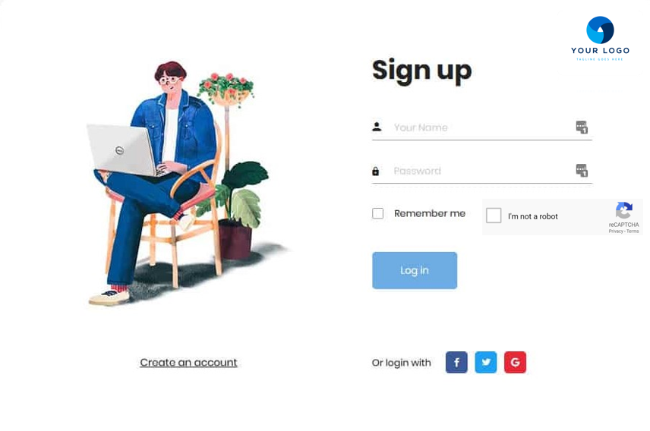
LOGIN
Login
Here in this login page, different users like Individuals, Company/Institutions, Trainers, Admin can access into the portal using this page.

Slide 3

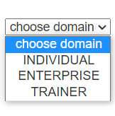
CREATE ACCOUNT
Enter your details
NEXT
This page is for registering new user profile for accessing the registration page by choosing the respective domain.

Slide 4
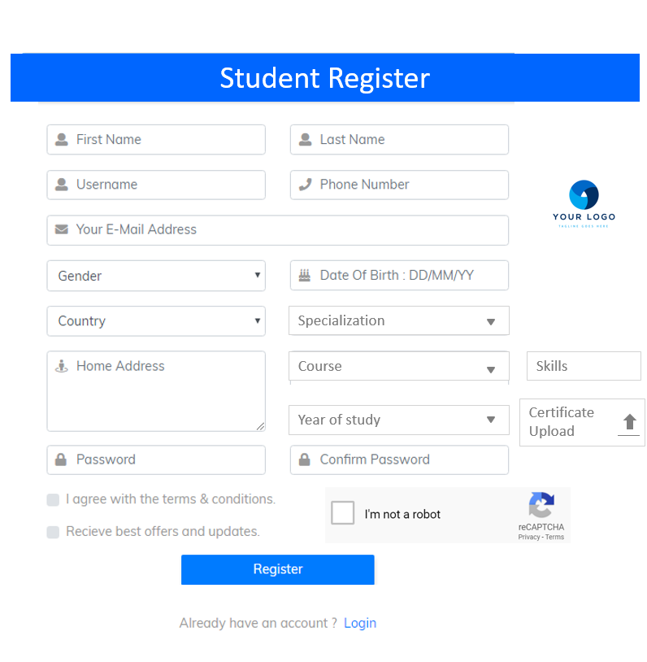
INDIVIDUAL REGISTER
Individual
Enterprise
Trainer
Individuals / Students who are seeking to join this platform for developing their skills can use this page for register

Slide 5
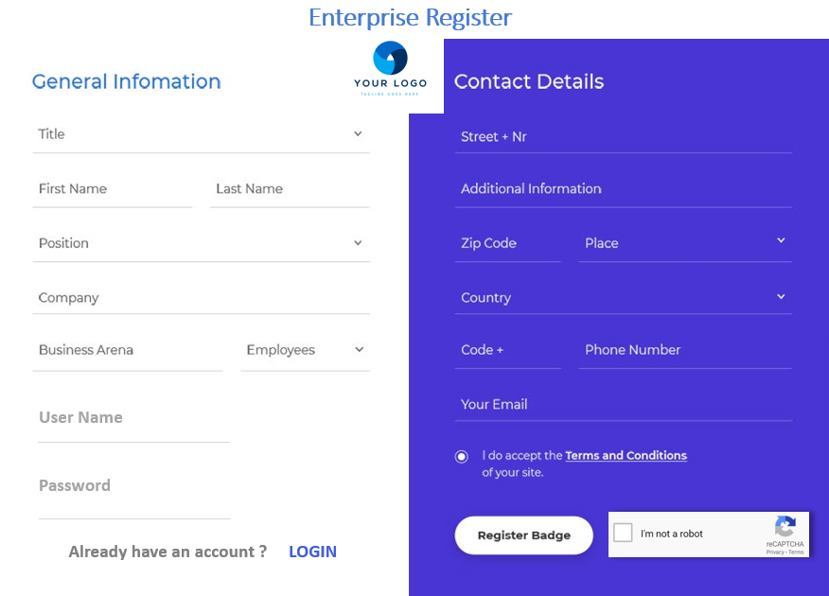
ENTERPRISES REGISTER
Individual
Enterprise
Trainer
Persons from various institution and companies can register their details here for accessing the platform

Slide 6
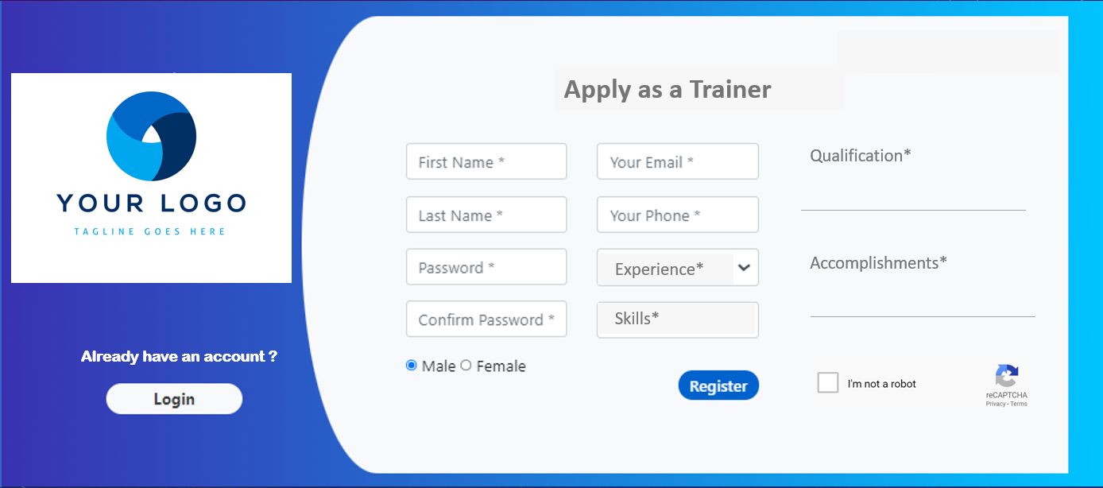
TRAINER REGISTER
Individual
Enterprise
Trainer
Various skilled trainers or faculty can register to enroll as a trainer in this platform and can teach the students accordingly.

